Slide 1

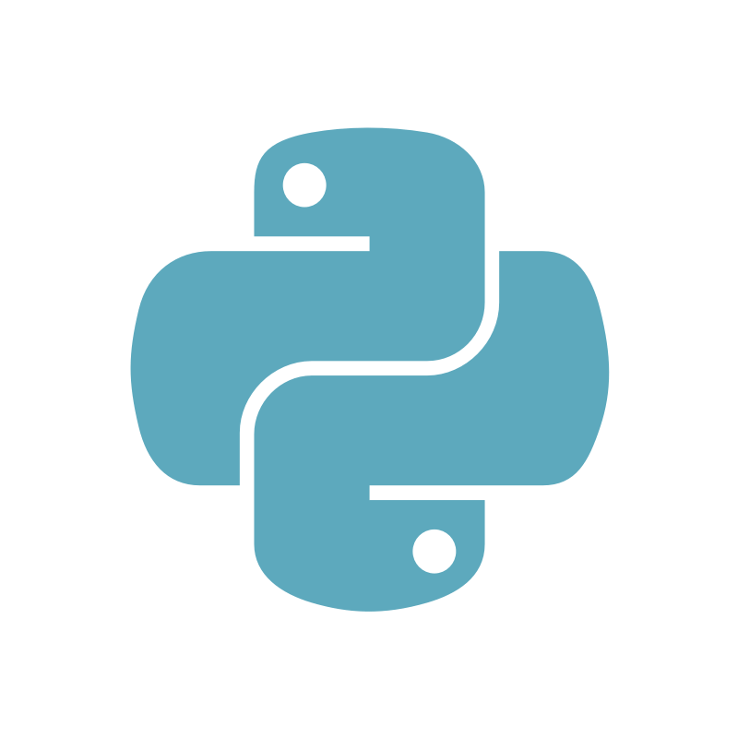
Task
Notifier Assistant
A Project based on Python

Slide 2


Objective
Implementation
01
03
Features
Future Plans
02
04
Quick Overview
What is the main objective behind this project.
What are the technologies used in this project.
What are the main features of this project.
Future plans to take this project to the next level.

Slide 3
Objective
01

Slide 4
Main Ideas Behind This
Get the alarm of each task on time
To get Reminders and Task Notifications easily
Especially designed for teams and groups

Slide 5
Features
02

Slide 6

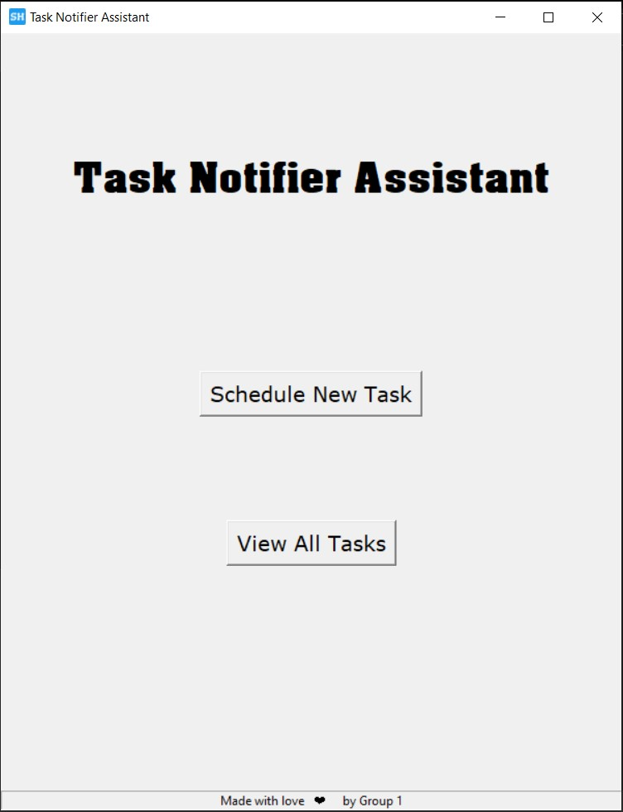
How it looks like
Frontend file

Slide 7
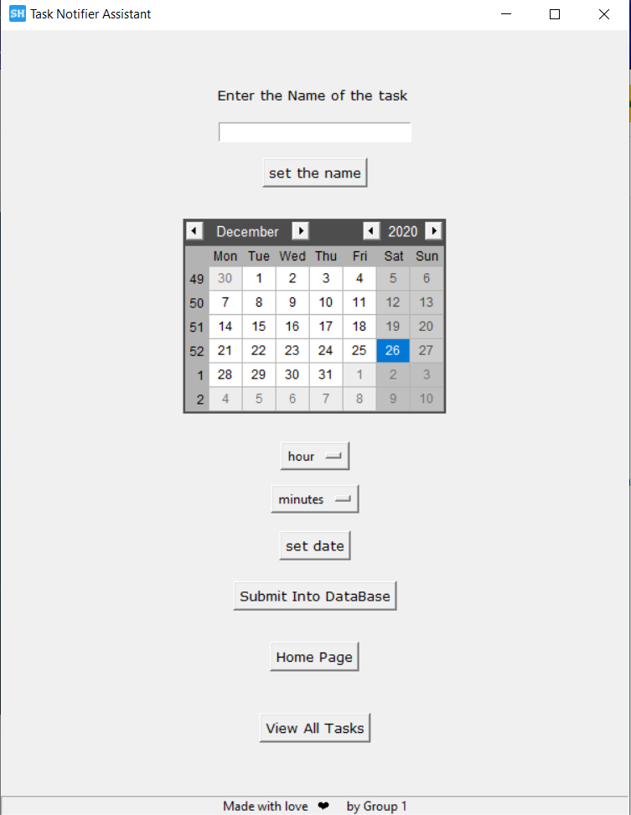
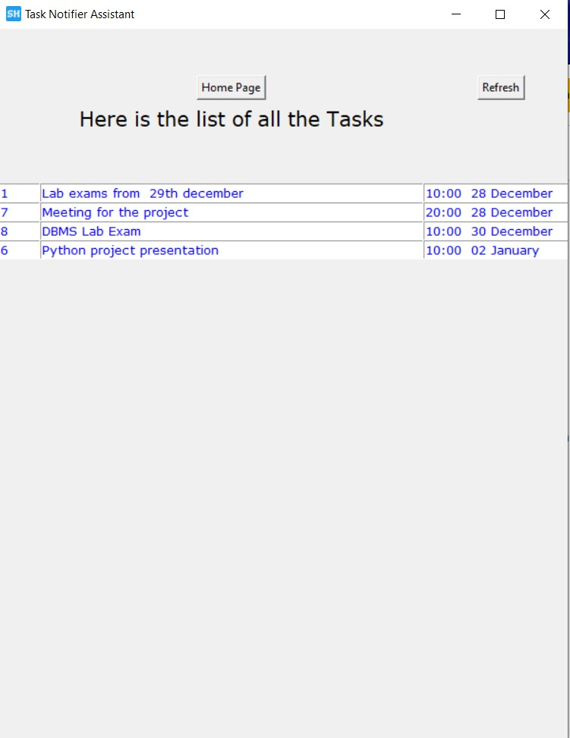

Slide 8

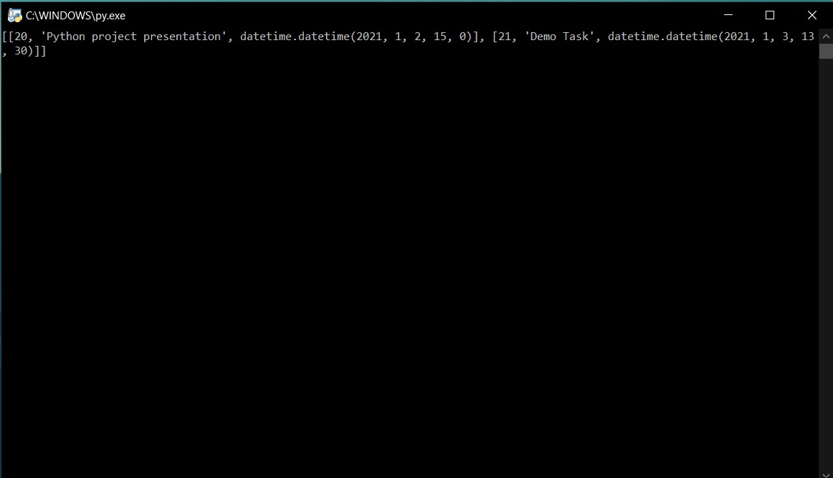
Backend file

Slide 9




Features
Save all tasks of the team in a shared database
Reminds you on time with its alarm feature
Get instant message on Telegram App
Text to speech support for the alarm sound

Slide 10
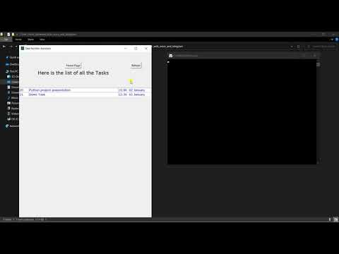

Slide 11
Implementation
03

Slide 12








Technologies Used
Used Tkinter to make the GUI of the software
Used Heroku Server to deploy the Backend File
Tkinter
Server
Data base
Telegram API
Used a MySQL database instance of Google Cloud Platform
Used Telegram’s Open Source API to send Messages
Text to Speech
Used PyTTSX library to convert Text to Speech

Slide 13
Timeline of Features Added
Alarm functionality based on the time of the task
Real time notifications on Telegram App
Alarm
Notifications
Save and Fetch
Text to Speech
Server
Save and Fetch data from a shared MySQL DB on Google Cloud
Alarm sound based on the task name
Backend Script deployed on Heroku Server

Slide 14
Future Plans
04

Slide 15







Long way to go
Multiple Team Support
2021
2021
Login and Authentication
SMS support Integration
2021
2022
Web and App both platform availability
Open for public i.e Commercial Rollout
2022

Slide 16
ABOUT US
Group 1
We are a group of 4 people passionate about technology and programming.
.
Shubham Khandelwal (2019KUCP1008)
Piyush Gupta (2019KUCP1024)
Yash Agrawal (2019KUCP1027)
Aman Jain (2019KUCP1122)
THANK YOU!!
Logos and Icons Credit : flaticon.com

